Slide 1
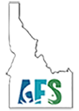

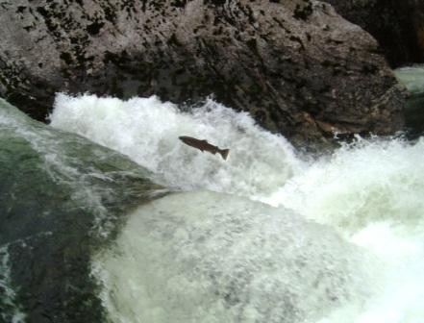
Following Fishes:
Anadromous Fish of Idaho
An Epic Journey
for Courageous Fish
Steelhead at Selway Falls

Slide 2
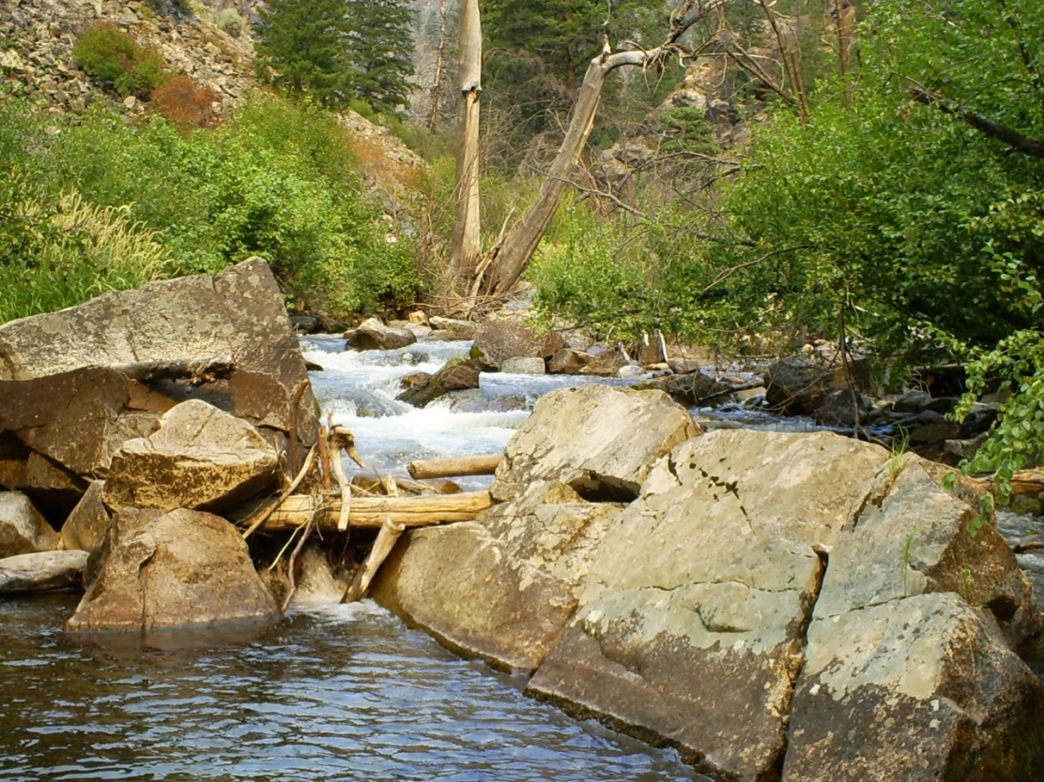
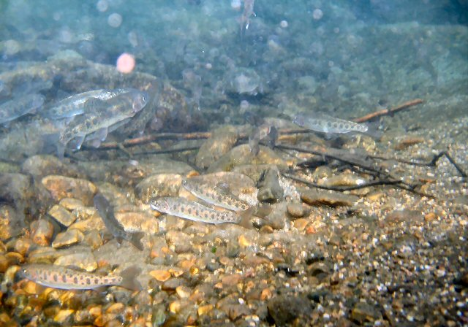
Description:
This is a 3 day lesson and activity including:
Day 1: Salmon biology and research
Day 2: “Following Fishes” guided internet activity
Day 3: Class discussion
Juvenile Steelhead Parr
Camas Creek, Idaho

Slide 3
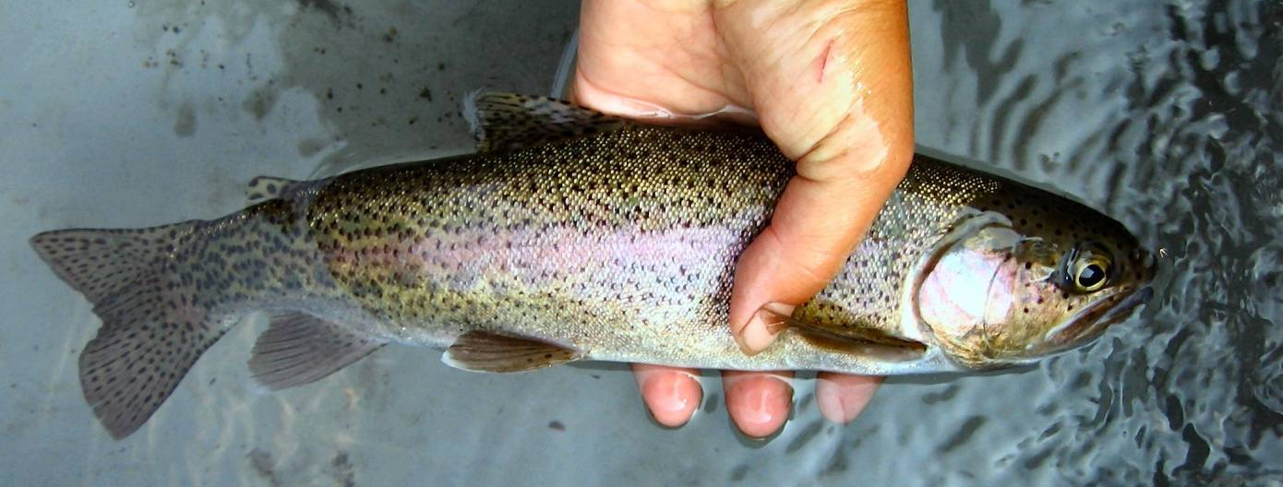
Day 1: Salmon biology and research
General salmon vocabulary
Basic salmon life history
Idaho salmon descriptions
Dangers to migrating salmon
Salmon research methods and an overview of research technology
Rainbow/Steelhead Trout

Slide 4
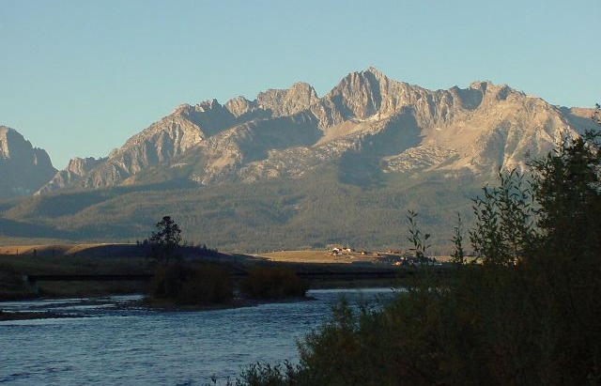
Vocabulary 1: Movement
Anadromous: fish born in fresh water streams migrate to the ocean as juveniles. They mature in the ocean and return to their home streams to reproduce.
Migration: movement from one place to another
Emigration: movement out of an area
Immigration: movement into an area
Salmon River

Slide 5
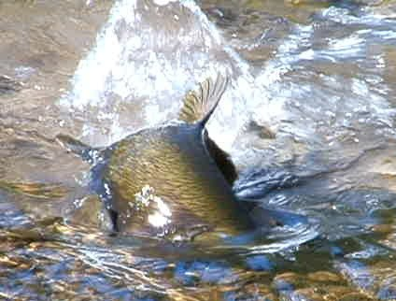
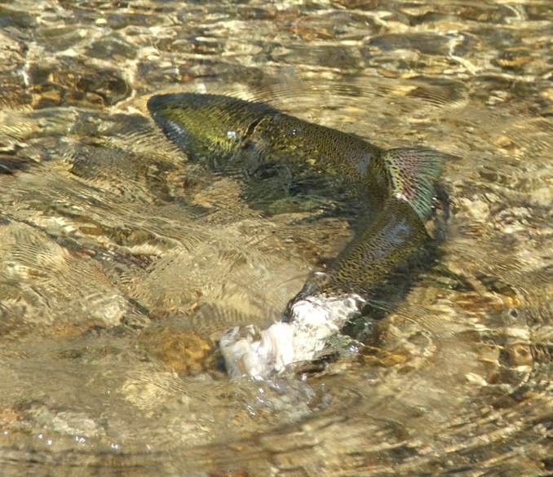
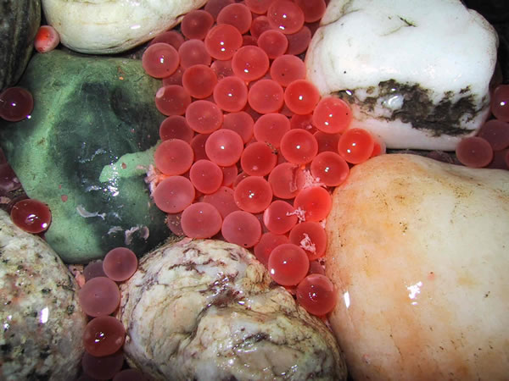
Vocabulary 2: Reproduction
Redd: the gravel nest created by a female salmon with her tail.
Spawn: the mating behavior of salmon in which the female builds a redd in the gravel stream bottom.
  She then lays eggs that the male fertilizes by releasing sperm.
  The redd is covered with small gravel.
Female Chinook building a redd
Redd: eggs in gravel

Slide 6
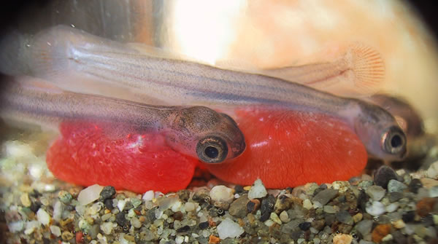
Vocabulary 3: Life Stages
Alevin: newly hatched fish that stays in the redd as it develops further while feeding off of a yolk sack.
Fry: a juvenile salmon that has emerged from the redd.
Parr: juvenile salmon feeding and growing in freshwater. These have dark bars 0r spots on their sides.
Smolt: a juvenile salmon emigrating downstream toward the ocean. This loses its spots and takes on a silvery hue.
Alevins emerging as fry

Slide 7
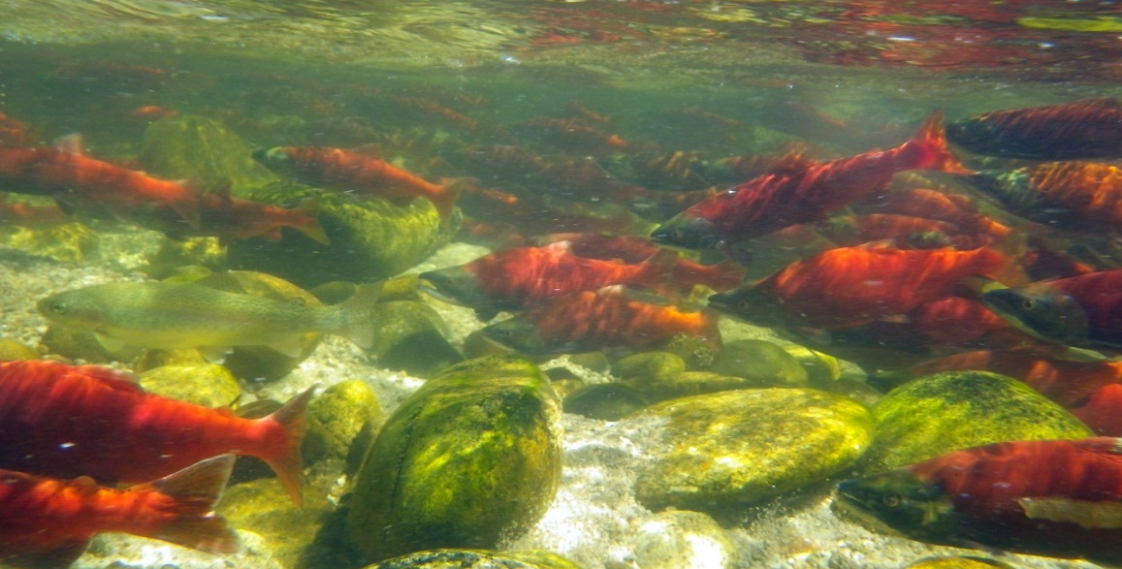
To Stay or Go: a life history decision
Salmon species divide into two distinct populations:
  Some fry remain in the stream and become residents.
  Some fry turn into smolts and emigrate.
The decision to smolt is influenced by the growth rate of the fish and it’s genetic makeup.
Resident and anadromous populations of the same species can inter-mate.
Spawning Kokanee: Can you spot the resident trout?

Slide 8
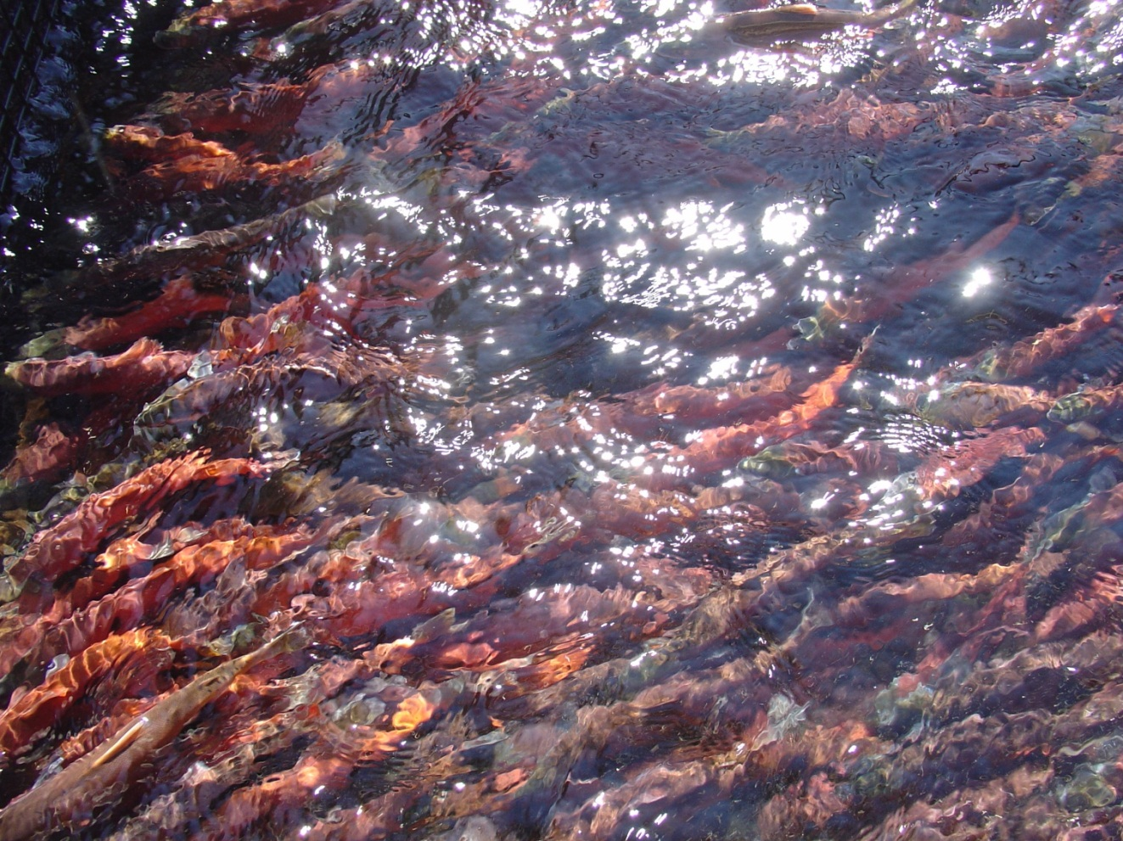
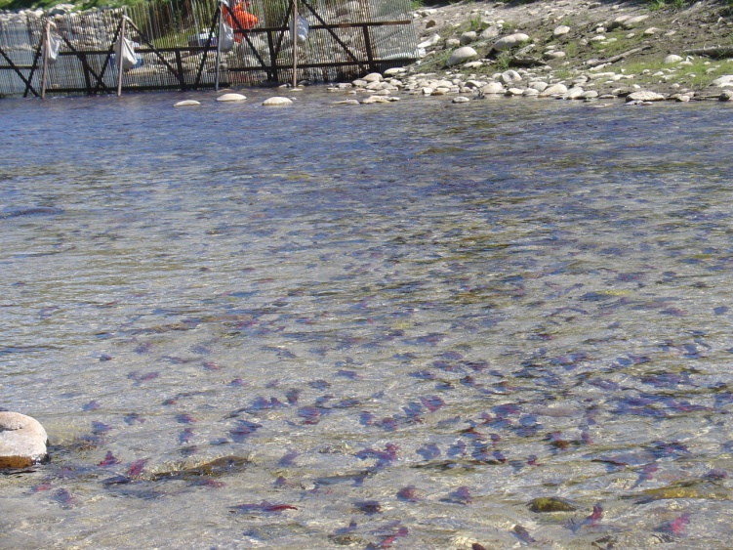
The Run: return of adult fish
Fish of the same species return to spawn at the same time
Most salmon die after spawning.
Kokanee run bunched up at a weir.
Notes:
Those look like Kokanee

Slide 9
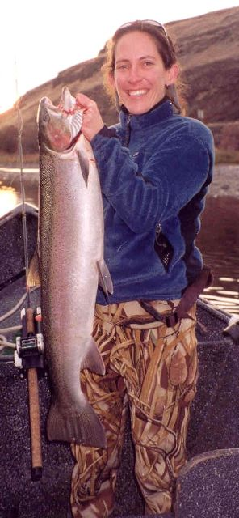
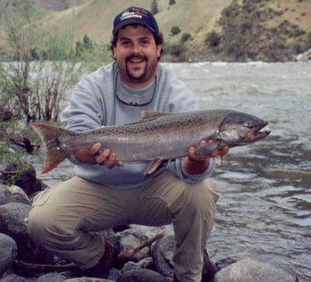
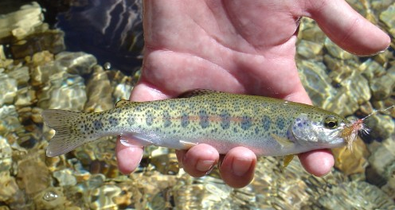
Oncorhynchus mykiss:
Resident: Rainbow Trout
Anadromous: Steelhead Trout
  Spend 1 to 6 years in freshwater before emigrating.
  Spend 1 to 3 years in the ocean.
  After spawning, some can return to the ocean and then spawn a second time.
Hatchery Adult Steelhead
Wild Juvenile Steelhead

Slide 10
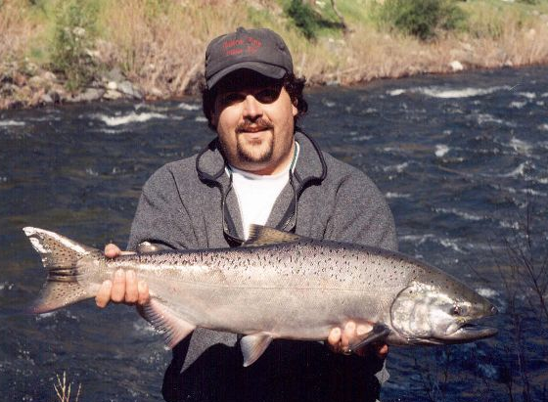
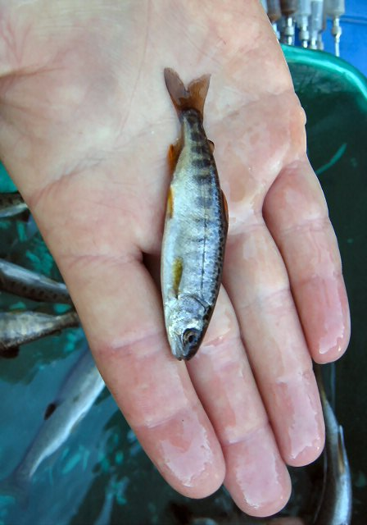
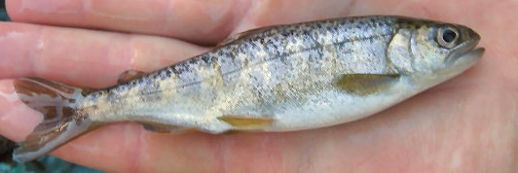
Oncorhynchus tshawytscha:
Resident: none
Anadromous: Chinook (King) Salmon
  Spend 0 to 2 years in freshwater before emigrating.
  Spend 0 to 4 years in the ocean.
    Jack: an adult male that goes to the ocean and returns to it’s home stream within a single year. Jills (female) are not common.
Wild Adult Chinook
Wild Juvenile Chinook

Slide 11
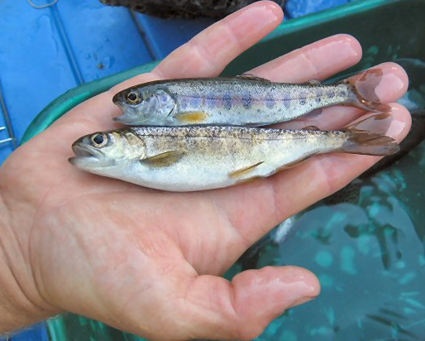
It is often difficult to tell Chinook and Steelhead juveniles apart.
Juvenile Fish:
Steelhead (rainbow) trout
Chinook salmon

Slide 12
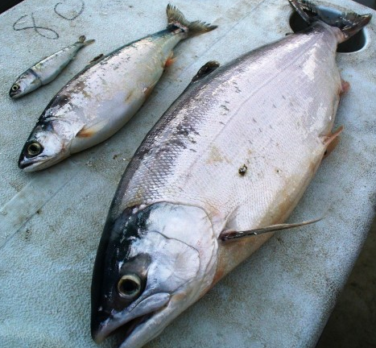
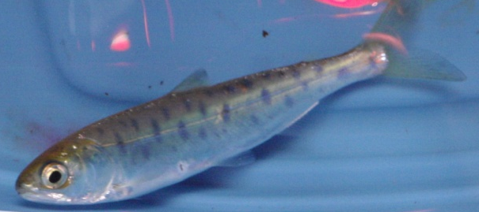
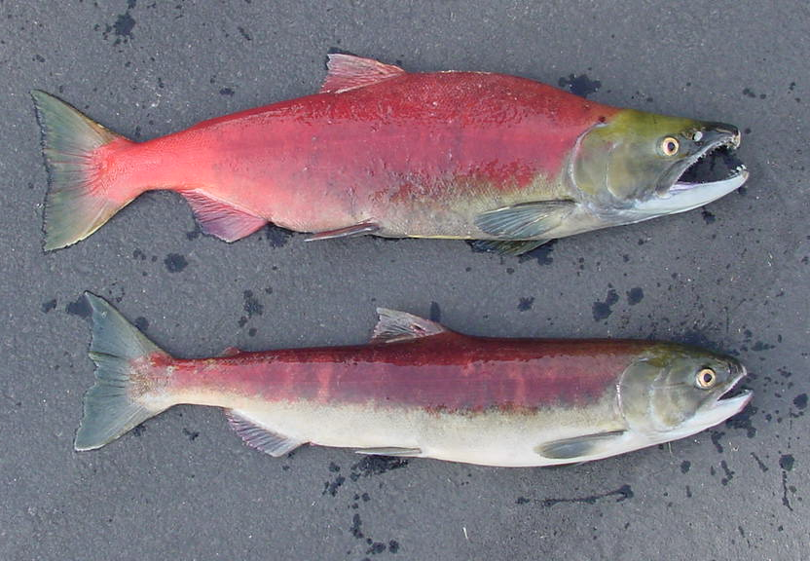
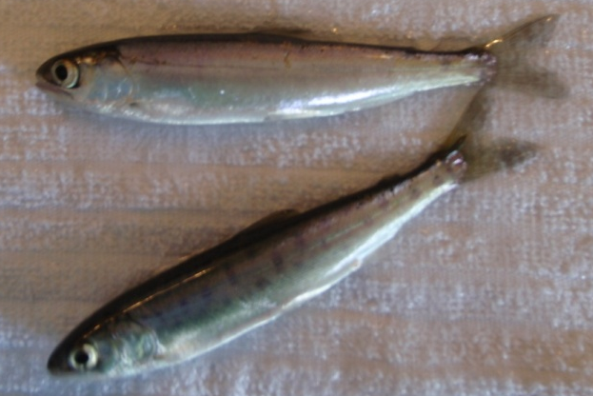
Oncorhynchus nerka:
Resident: Kokanee
Anadromous: Sockeye Salmon
  Spend 1 to 2 years in fresh water streams before emigrating.
  Spend 1 to 3 years in the ocean.
Kokanee
Male
As fry turn into smolts they lose their spots.
Female

Slide 13
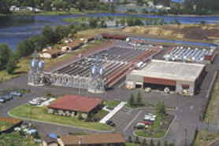
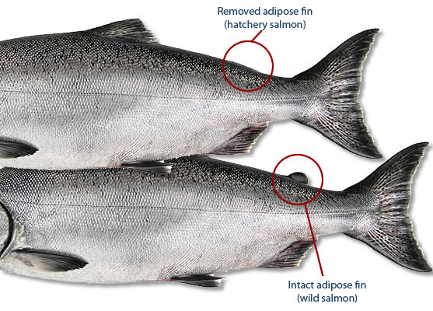
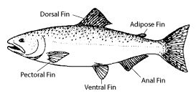
Hatchery vs. Wild Fish:
Clearwater Hatchery
Since Idaho’s salmon are listed as threatened under the Endangered Species Act, we balance harvest and dam impacts by producing fish in hatcheries.
  To mark a fish as “hatchery” instead of wild the adipose fin is removed.
Only hatchery fish can be harvested.
  If a wild fish is caught it must be released (except in some tribal fisheries).

Slide 14
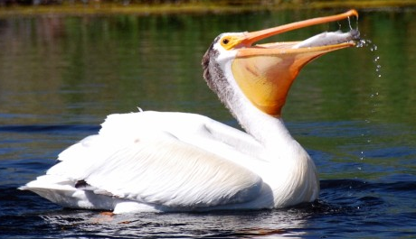
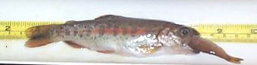
Dangers to Juvenile Salmon:
Predators: eagle, hawk, osprey, bear, raccoon, muskrat, otter, bigger fish, seals, pelicans, people
Starvation: fish eat insects who's populations can vary depending depending on habitat quality
Pollution: herbicides, pesticides, agricultural and industrial runoff,
Low water flow: intermittent streams dry out or water is diverted and fish are stranded
Increased water temp: higher temperatures decrease oxygen content and lead to suffocation
Erosion: fine soil particles bury redds and suffocate eggs and hatchling fish
Pelican eating trout
Steelhead juvenile eating smaller fish

Slide 15
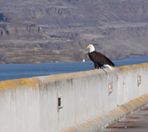
Dangers Posed by Dams:
Fish get lost in large reservoirs and do not complete their migration down to the ocean or back to natal streams.
Fish are killed in turbines.
  Screens keep most fish from entering the turbine area and funnel them into fish passage tunnels. Some fish still get caught in turbine blades.
The dam creates a bottleneck where large predators wait for fish.
  Animals like otters, seals, pikeminnows, and raptors know fish have limited travel options and position themselves where they can easily eat passing fish.
Bald Eagle on the Dalles Dam

Slide 16
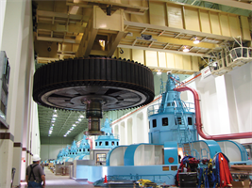
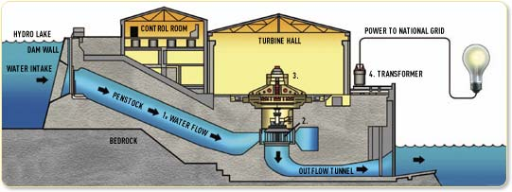
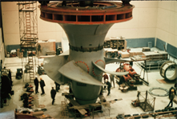
Dam Construction:
The Powerhouse with generators.
Each generator is powered by a fan shaped turbine (below).
Basic dam characteristics:
  Turbine ⁽²⁾ powered by water flow ⁽¹⁾
  Generator ⁽³⁾ to convert kinetic energy of water flow into electricity
  Energy transfer system ⁽⁴⁾
1,200-ton rotor

Slide 17
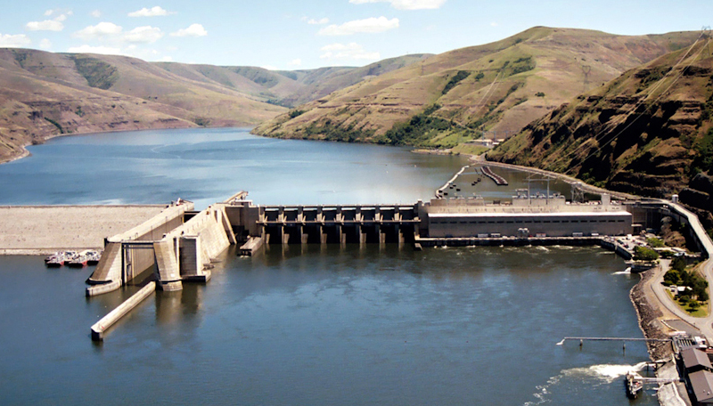
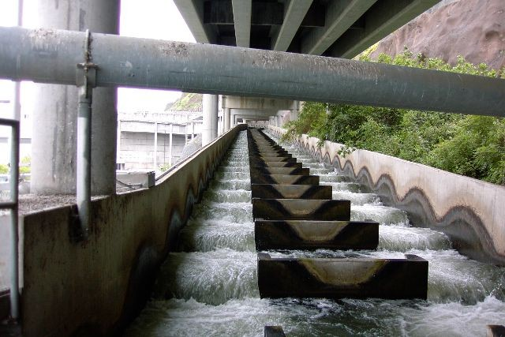
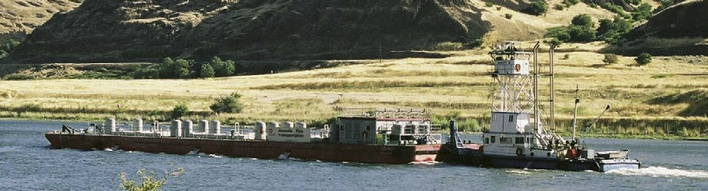
Crossing the Dams:
Lower Granite Dam
A dam is a solid structure and some dams completely prevent fish movement. Others have pathways for fish migration.
  Spillway: water over the top of the dam
  Juvenile bypass: tunnel built through the dam to facilitate juvenile fish movement
  Turbine: water passing under the dam turns fan shaped blades to create electricity
  Fish ladder: returning adults climb up and over every dam
  Barge: juvenile fish are collected from reservoirs and transported down stream in large tank boats
  Lock: allows boats to move from one side of the dam to the other
Lock Spillway Powerhouse
Fish Ladder
Fish Ladder
Juvenile Fish Barge

Slide 18
Fish survival: a Chinook example
For the last 10 years:
  There are about 970 million juvenile Chinook born in Idaho streams each year. (969,840,000 )
  Of those juveniles only 0.2% survive to become smolts. (1,500,000)
  1.7% of fish that survive to smolt return as adults. (25,839)
  Of all the fish that are born less than 1% return to spawn. (0.003%)
Why do they choose to migrate?
  Our small cold streams don’t provide enough resources to sustain large populations. It is better for the fish to migrate to the ocean and feed there. Then they come back to their natal streams to spawn because the eggs needs cold, shallow, gravel beds.
FINAL 2012 CSS Annual Report

Slide 19
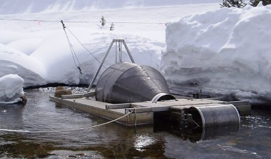
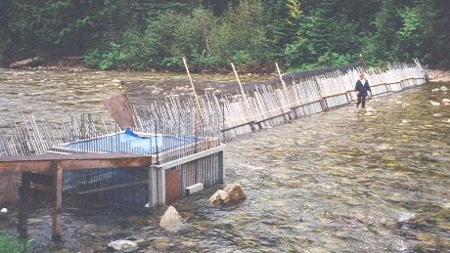
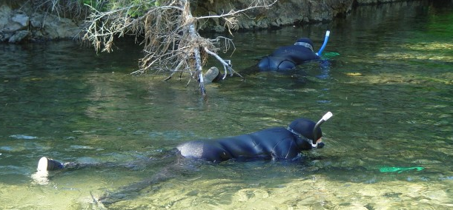
Fish Research:
Screw Trap
In order to study fish…we have to catch them first:
  Screw Trap: funnels juvenile fish into a holding tank
  Weir: blocks a stream so adult fish can be trapped and sampled before passing
  Snorkeling Survey: fish are observed and counted
Since salmon are listed as threatened under the Endangered Species Act, sampling techniques must be non lethal and fish must be returned to their streams.
Picket Weir
Snorkeling Crew

Slide 20
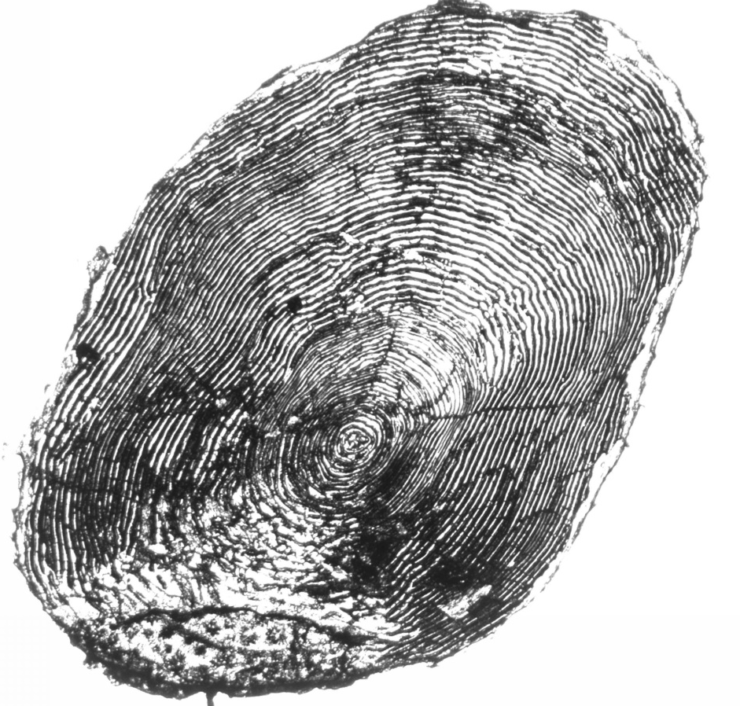
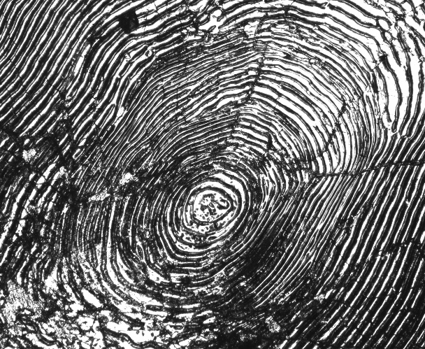
Sampling Techniques:
When a fish is caught for sampling, several techniques are used:
  Fin clip: part of a fin tissue is removed for genetic analysis
  Scale sample: a few scales are scraped off and used to determine fish age
  Fish Characteristics: sex, length, weight, and condition are recorded
  Tagging: various tags are used to track fish
Saltwater growth
Adult Scale
Freshwater Growth

Slide 21
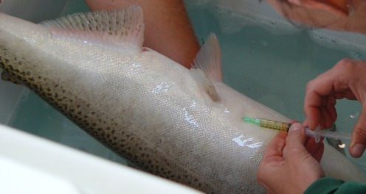
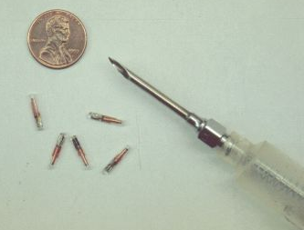
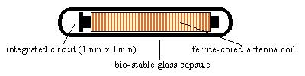
Fish Tagging:
Pit tags
PIT tag: placed inside a fish’s abdomen,
  “PIT” = passive integrated transponder
  has a unique number that is recorded in the PTAGIS database
  Each pit tag has a unique code that can be read by an interrogator like those placed in an array or on dams
PIT Array: a wire in a stream or dam that detects the passage of a fish with a PIT tag and records it in the Ptagis database
PTAGIS database: a public database that records the movement of fish and their individual characteristics
  (PTAGIS= pit tag information system)
Columbia River DART database: daily data plus historic information dating back to 1878 focusing on the Columbia Basin dams and fish passage
  (DART=data access in real time)

Slide 22
Technology and Fish Management:
A simplified and general overview:
Place a screw trap in the steam.
Count, measure, and pit tag all juvenile fish captured (C) .
Release a known number of tagged fish upstream above the screw trap (M).
Count recaptured fish (you know by the PIT tag) (R) .
Estimate total juvenile fish population: N=C/(R/M).
Use PIT Array to track fish movement and survival as fish emigrate and again as they immigrate.
  All this data is saved in the PTAGIS database.
Use PIT tag detection combined with dam fish passage window counters and population structure to estimate fish return population.
  This is found in the DART database.
Use return estimates to set harvest limits.
How big are you?

Slide 23
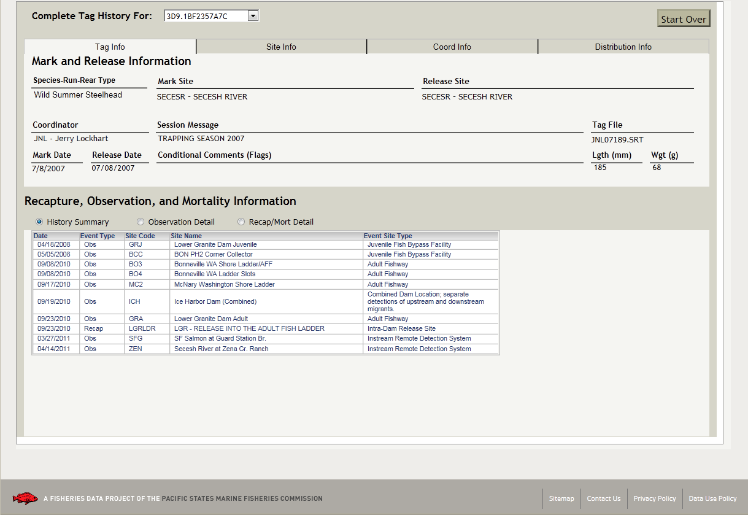
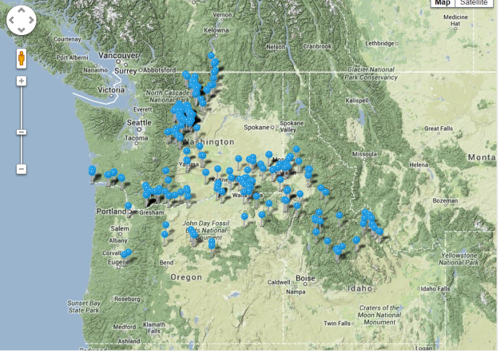
Traveling on the Pit Array:
When a fish is tagged, it’s species, measurements, location, and the tag number, are all recorded in the Ptagis database.
  Each time a tagged fish crosses an array it’s location and the date are recorded.
  Using the PIT tag number all available data can be retrieved from the database
Screen shot from PTAGIS
Map of Pit Arrays

Slide 24
Day 2: Following Fishes
For the next section we will be working on computers.
Each of you will be assigned 1 real pit tag number.
You will use the PTAGIS and DART databases to answer a series of questions.
Then we will use this data to plot fish movement on a large map and discuss the survival of migrating fish.

Slide 25

Day 3: Mapping Fish Movement
Today we will combine all of our data and plot this on a map
We will then discuss our results.
Map of Pit Arrays (this is from the PTAGIS web site)

Slide 26
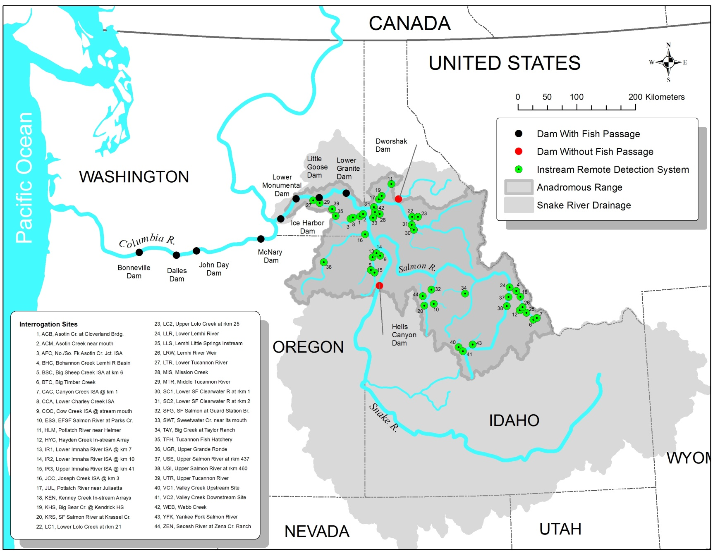
The Snake River Basin:

Slide 27
Guiding questions:
What did we learn from this exercise?
  Dams?
  Fish migration?
  Geography?
  Technology?
  Careers?
What impacts have humans had on migrating salmon?
What impacts have salmon had on humans?
What do you think is going to happen in the future?
  Why?
Want more? Check out the newest F.I.S.H. at the Idaho Department of Fish and Game’s web site!
http://207.109.38.126/idaho/web/apps/index_main.php

Slide 28
Resources and Sources:
American Fisheries Society:
  http://fisheries.org/
Columbia Basin Research DART:
  http://www.cbr.washington.edu/dart
Federal Caucus of Salmon Recovery:
  http://www.salmonrecovery.gov/Home.aspx
Fish Passage Center:
  http://fpc.org/about_fpc.html
  FINAL 2012 CSS Annual Report - 11/30/12
Idaho Department of Fish and Game:
  http://fishandgame.idaho.gov/public/fish/
  IDFG Report Number 12-18 October 2012
Idaho Power:
  http://www.idahopower.com/OurEnvironment/FishAquatic/Chinook/default.cfm
Pacific States Marine Fisheries Commission:
  http://www.psmfc.org/
Ptagis.org :
  http://www.ptagis.org/home
Schoolgen (Genesis Energy):
  http://www.schoolgen.co.nz/a/a_assets_hydro.aspx
US Army Corps of Engineers: Walla Walla District
  http://www.nww.usace.army.mil/Missions/FishPrograms.aspx
Washington Department of Fish and Wildlife:
  http://wdfw.wa.gov/fishing/washington/fishing101/

